Slide 1
BOOTCAMP BY MISS LINDEKA

Slide 2
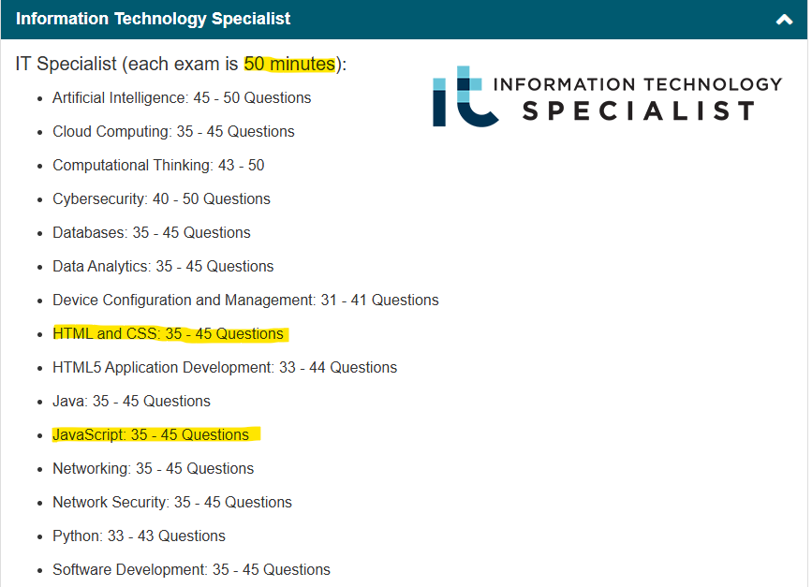

Slide 3
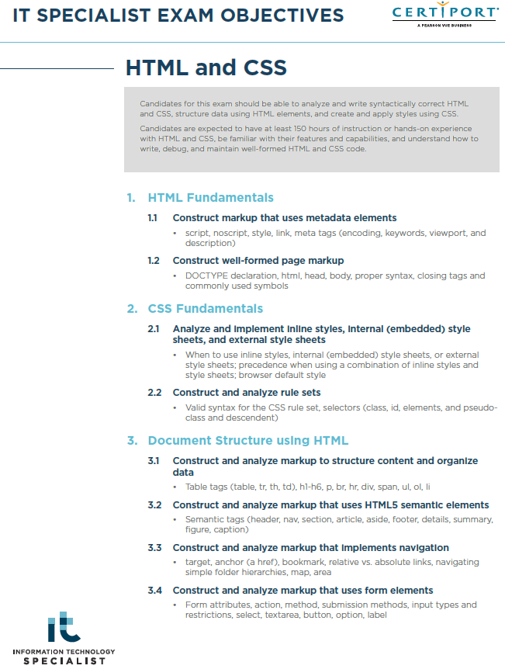
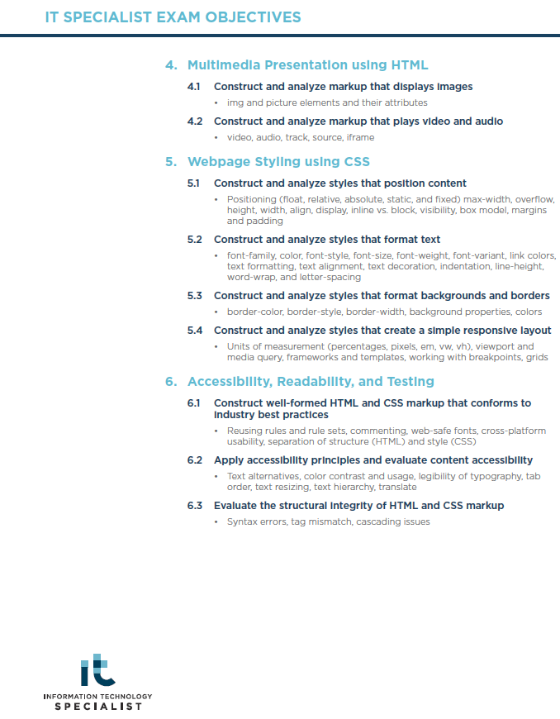

Slide 4



Slide 5
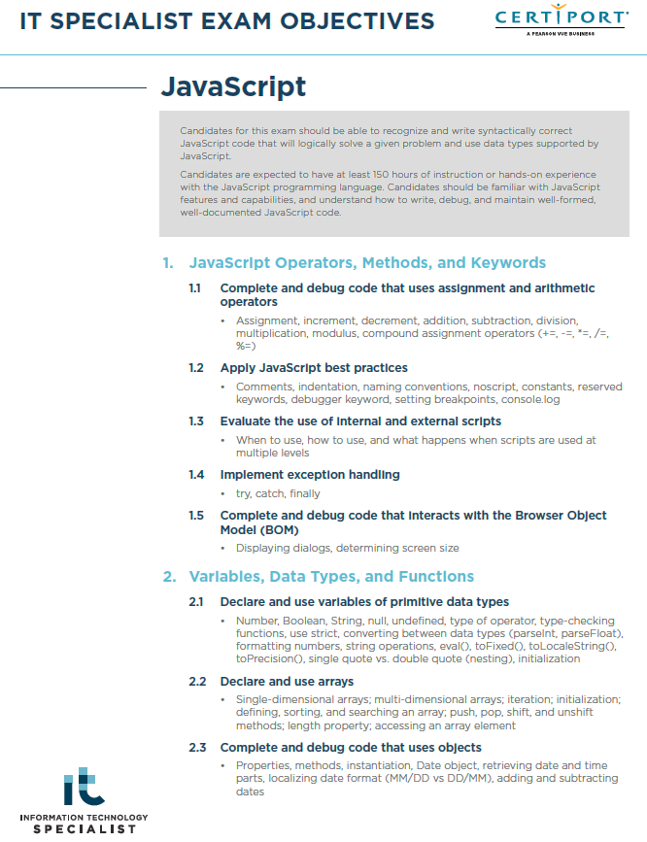
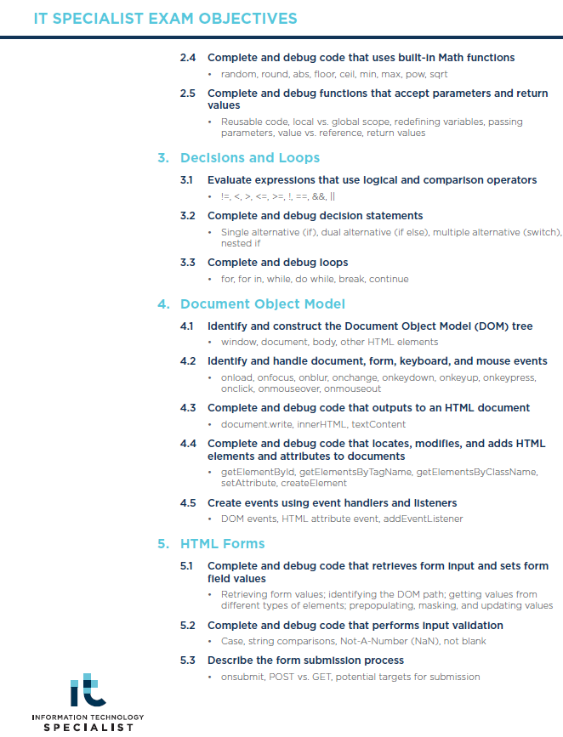

Slide 6


Slide 7

HTML5 & CSS3
EXAM OBJECTIVES
2025 CTU Training Solutions | All Rights Reserved | ctutraining.ac.za

Slide 8
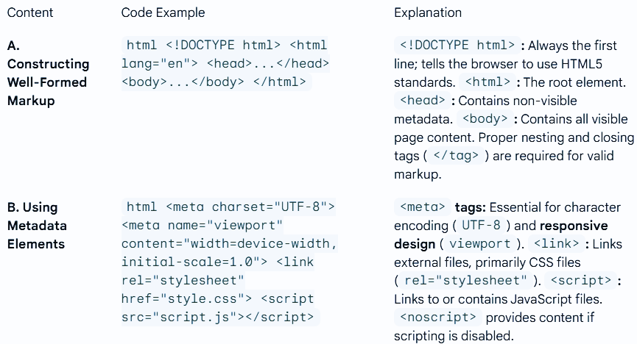
HTML Fundamentals

Slide 9
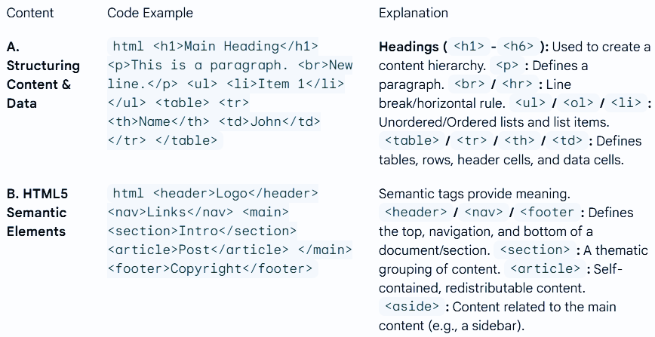
Document Structure and Semantics

Slide 10
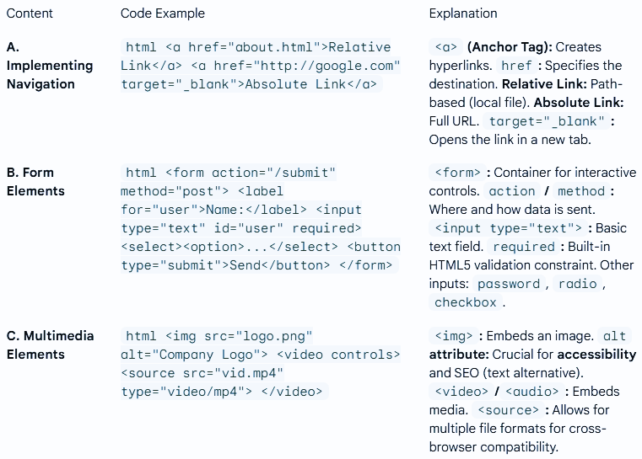
Navigation, Forms, and Media

Slide 11
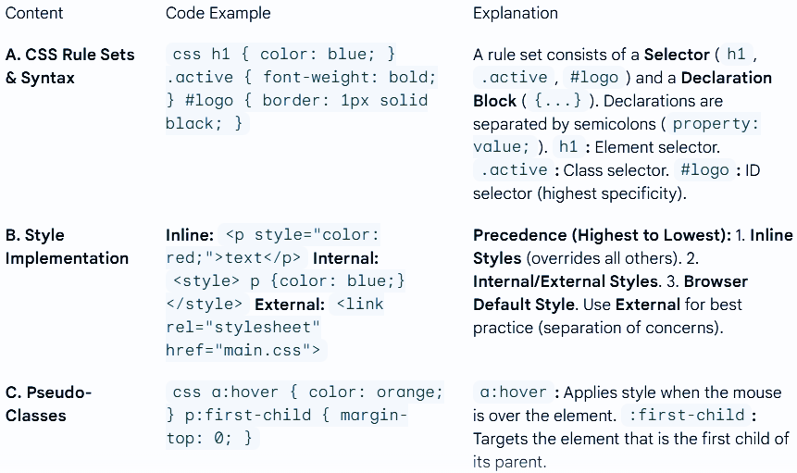
CSS Fundamentals and Precedence

Slide 12
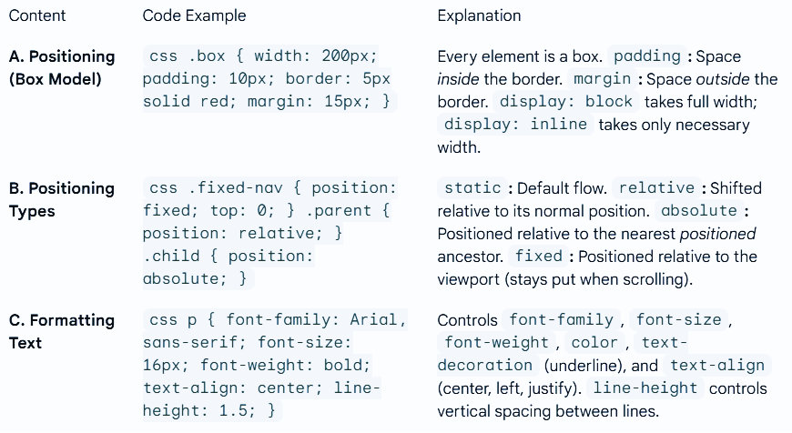
Webpage Styling: Layout and Formatting

Slide 13
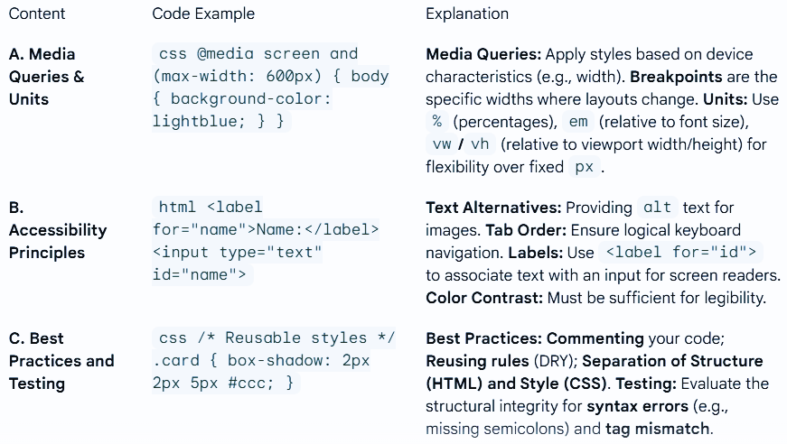
Responsive Design and Code Quality

Slide 14
JAVASCRIPT
EXAM OBJECTIVES
2025 CTU Training Solutions | All Rights Reserved | ctutraining.ac.za

Slide 15
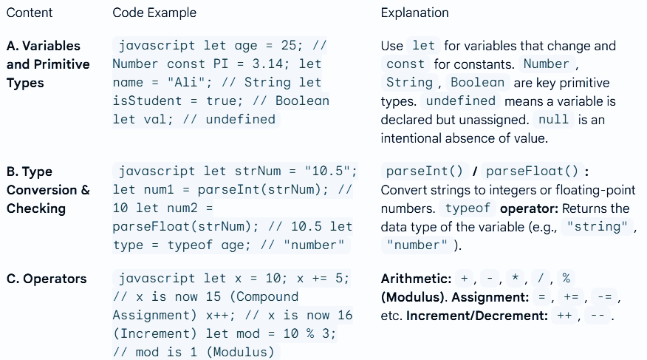
Variables, Data Types, and Operators

Slide 16
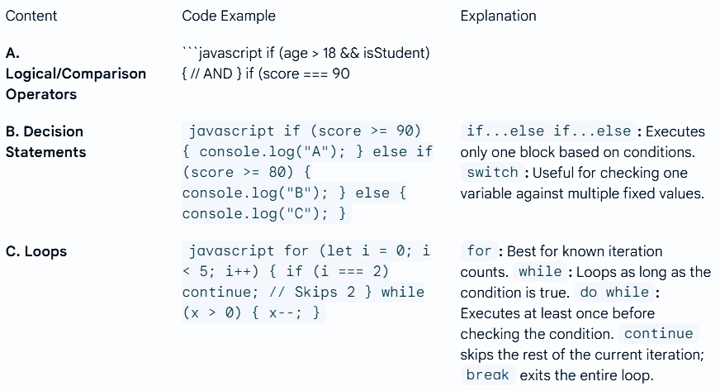
Control Flow: Decisions and Loops

Slide 17
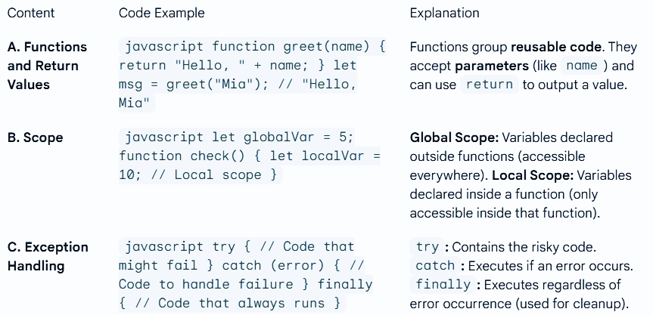
Functions, Scope, and Errors

Slide 18
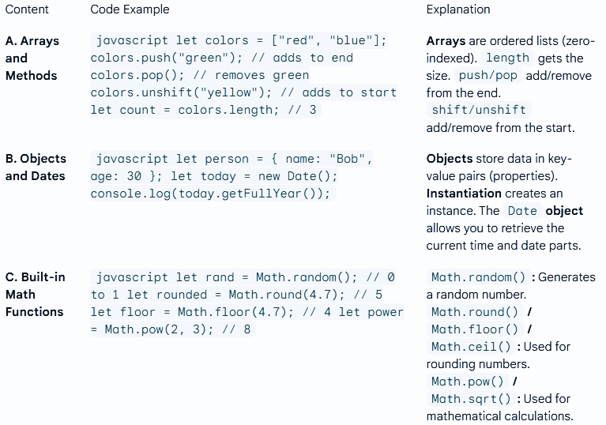
Arrays, Objects, and Math

Slide 19
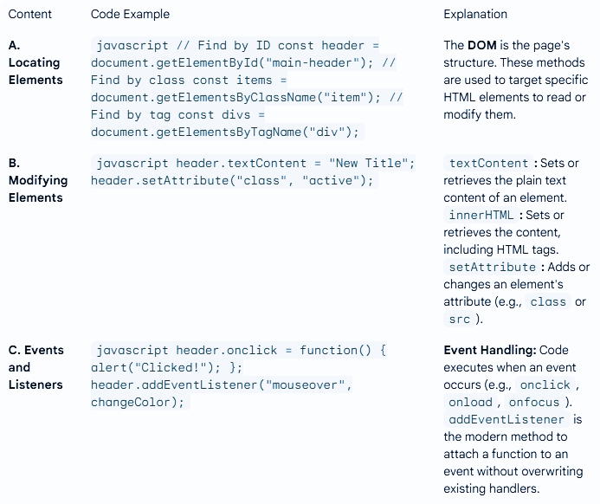
Document Object Model (DOM) Interaction

Slide 20
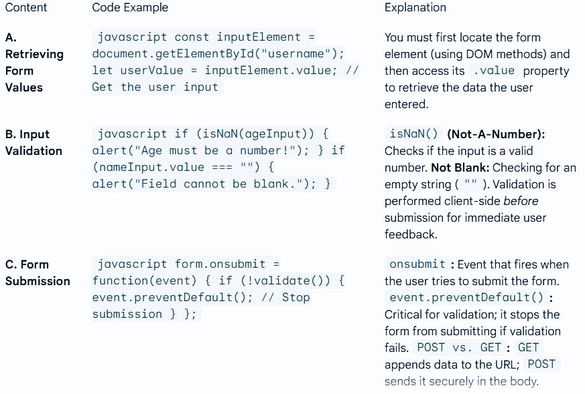
HTML Form Interaction

Slide 21
<END></END>
NOW YOU CAN TAKE A </BR>
☺ ☺ ☺

